Slide 1
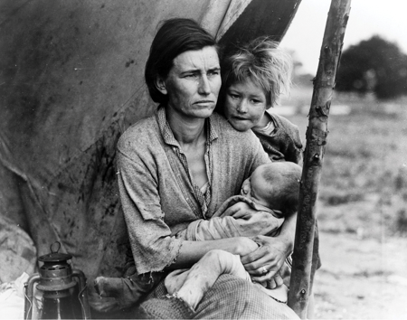
Chapter 14 : Recessions, Expansions & Debates
Wayne Geerling
University of Texas

Slide 2
Big Questions
Why do recessions occur?
What happened during three major recessions?
What are the big disagreements in macroeconomics?

Slide 3
Recessions
Recessions are short-term economic downturns typically characterized by declines in real GDP growth and increases in the unemployment rate.
Recessions are caused by:
Declines in AD
Declines in AS

Slide 4
Declines in Aggregate Demand
Aggregate demand can decline for a number of reasons.
When AD shifts left, unemployment goes up, output goes down, and the price level declines.
In the long run, short-run aggregate supply adjusts to bring the economy to equilibrium.
Can be a lengthy and painful process.
Government can minimize these effects.
The most useful policies are demand-stimulating policies (spending increases, tax cuts, and expansion of money supply).

Slide 5

Declines in Aggregate Demand
100

Slide 6
Declines in Aggregate Supply
Declines in aggregate supply can be caused by shifts in both long-run and short-run AS curves.
Recessions caused by short-run AS shifts occur when input costs rise
By itself, it is a fairly harmless, quick recession.
Danger of triggering deeper recession.
Recessions caused by long-run AS shifts are caused by negative changes in resources, technology, and institutions.
Leads to permanent changes in an economy.

Slide 7
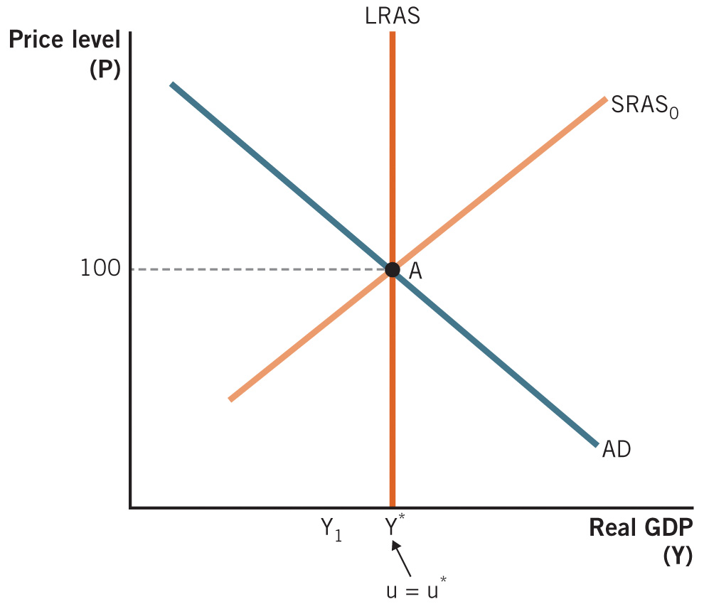
Declines in Short-Run Aggregate Supply

Slide 8
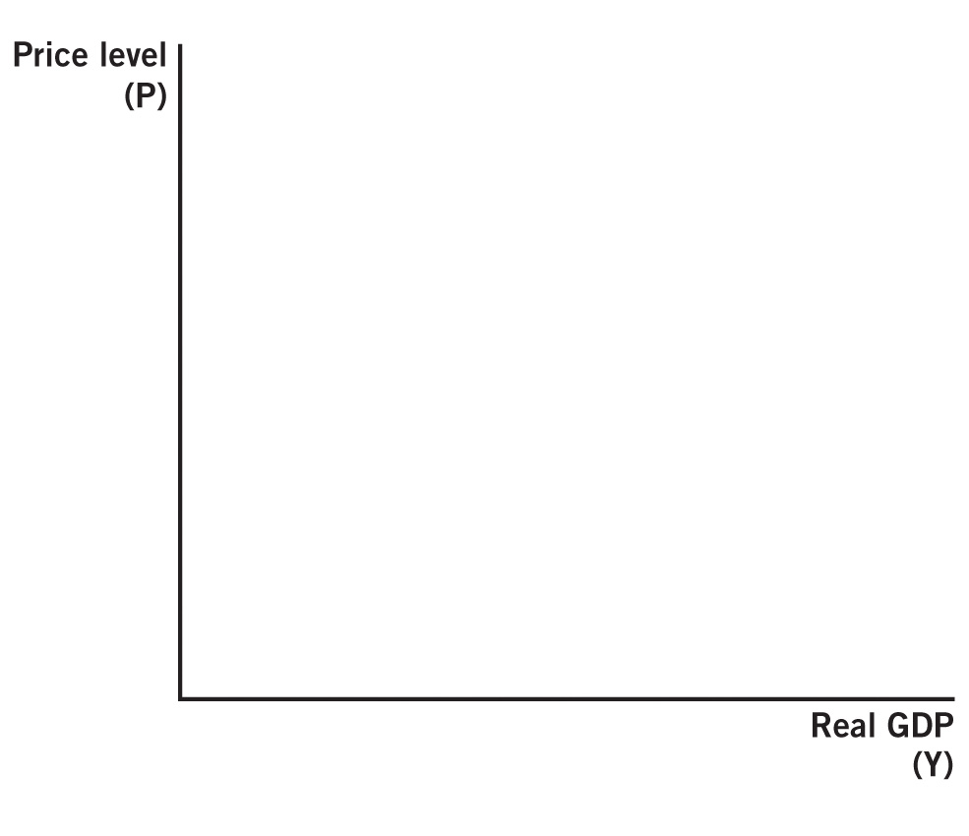
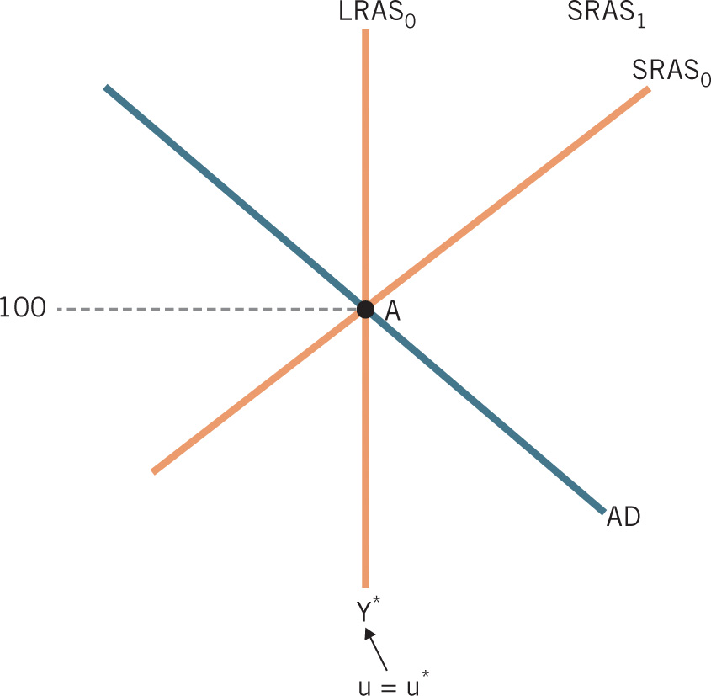
Declines in Long-Run Aggregate Supply

Slide 9
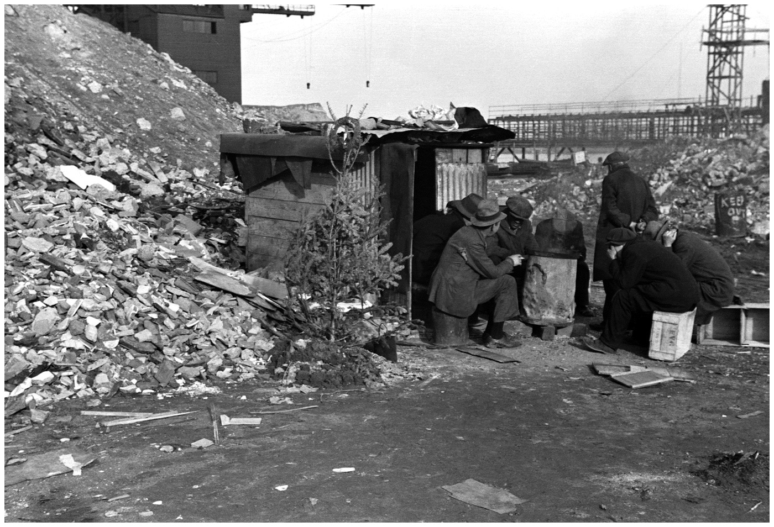
Great Depression Stock Market Crash
The Great Depression was much worse than the Great Recession.
Great Depression statistics:
Economy contracted by 30% from 1929 to 1933
It took 7 years for real GDP to return to its prerecession level.
Unemployment was 2.2% in 1929 and 25% in 1933.
The unemployment rate was 15% for almost the entire decade of the 1930s.

Slide 10
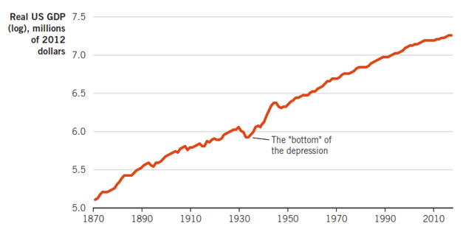
Real U.S. GDP 1870–2019

Slide 11
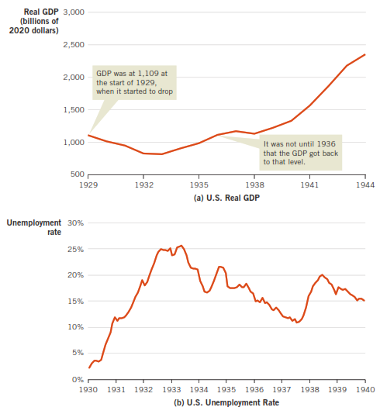
Real GDP & Unemployment during the Great Depression

Slide 12
Using AD–AS Model to Study the Great Depression
The Great Depression was characterized by some unique conditions:
It was actually two separate recessions (1929 to 1933 and 1937 to 1938).
Most remarkable: Prices across the economy fell throughout the decade.
At the end of the 1930s, the price level was still 20% lower than 1929.
Indicates that the primary cause of the Great Depression was a decrease in AD.

Slide 13
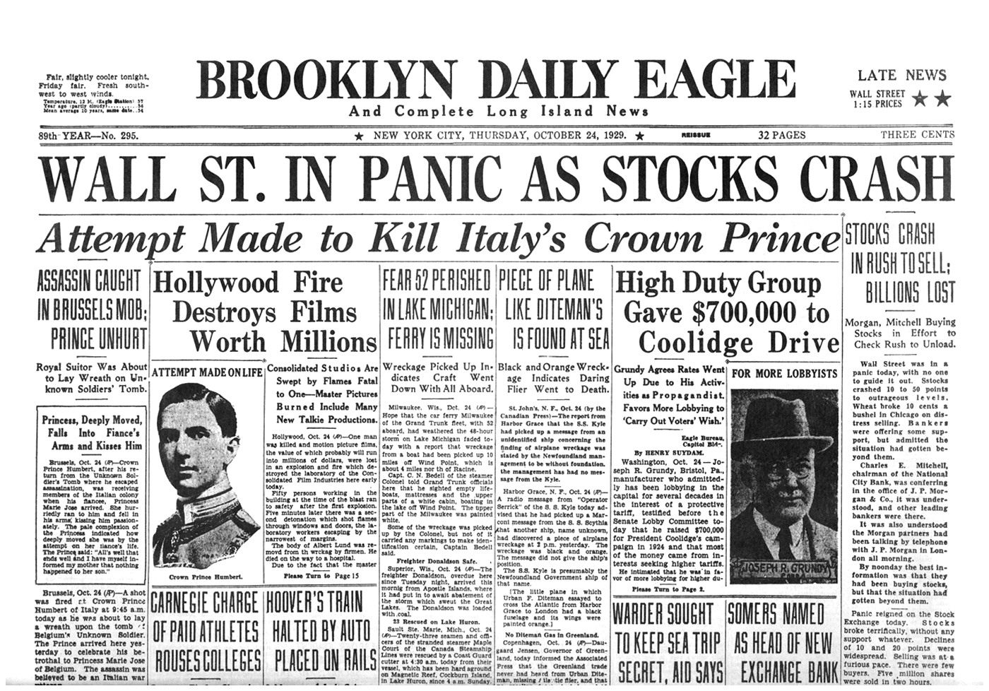
Causes of the Depression
Stock market crash (Oct. 29, 1929—Black Thursday)
Lower expected future income
C and I declined
1929–1932: stock prices fell by almost 90%.

Slide 14
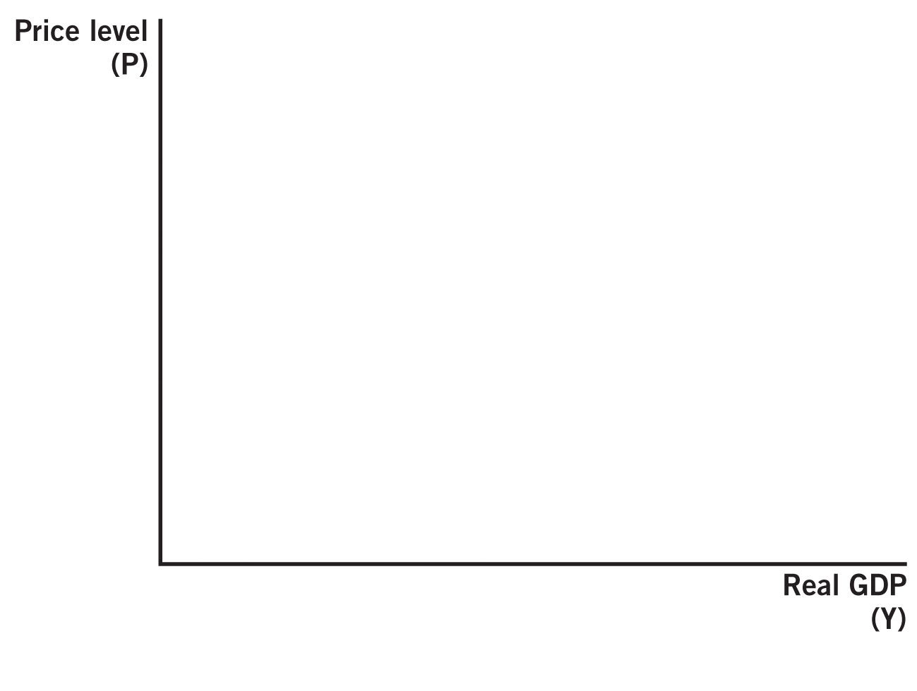
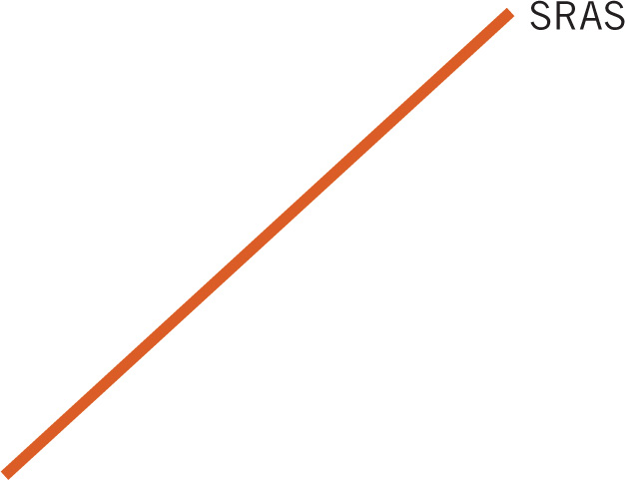

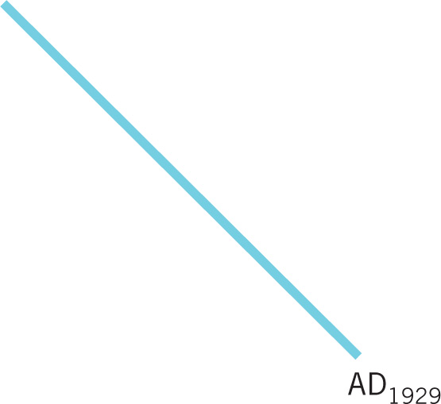


Great Depression, AS and AD Analysis

Slide 15
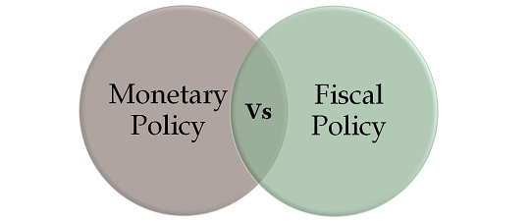
Macroeconomic Policy During the Great Depression
Adjusting the money supply
Use of government spending and taxes

Slide 16
Macroeconomic Policy Response
Government policy response:
Policymakers believed stock prices were too high
1928 and 1929: government reduce money supply
Lower money supply caused panic
This policy error caused bank problems all over the country as financial panic spread.
1930–1933: 9,000 banks failed
Government chose not to lend to these banks.
Thus, the money supply decreased even further.
1929–1933: money supply decreased by one-third.

Slide 17
The Great Recession (Housing market crash)
Officially from December 2007 to June 2009.
Longest recession since WWII.
Named the Great Recession.
Longer in length than other recessions.
Deeper in effects than other recessions.
Significant problems in the financial markets, similar to what happened during the Great Depression.
Even after the recession was over, unemployment recovered slowly and GDP grew slowly.

Slide 18
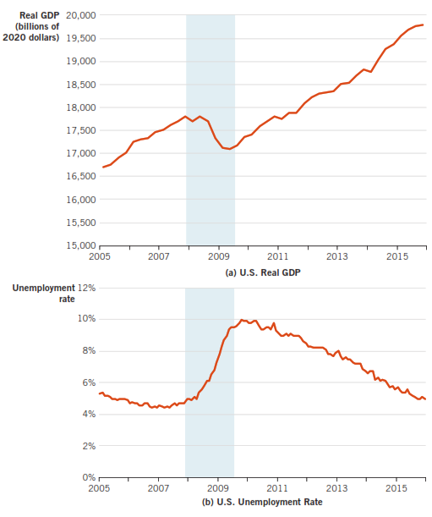
Real GDP & Unemployment during the Great Recession

Slide 19
Using AD–AS Model to Study the Great Recession
Initially, economists and policymakers believed the Great Recession was caused by lower AD.
Hindsight reveals that AS also fell.
Long-run aggregate supply fell due to:
An institutional breakdown in the loanable funds market.
New regulations (Dodd-Frank Act).

Slide 20
Shift in Long-Run Aggregate Supply
There was an institutional breakdown in the loanable funds market.
Real estate values fell in 2007.
As a result of securitization, falling real estate values led to a systematic problem in financial markets.
New regulations were placed to prevent another breakdown in the loanable funds market.
Dodd-Frank Act: The primary regulatory response to the financial turmoil that contributed to the Great Recession.

Slide 21

NINJA Loans
No Income, No Job, or Assets
What?!

Slide 22
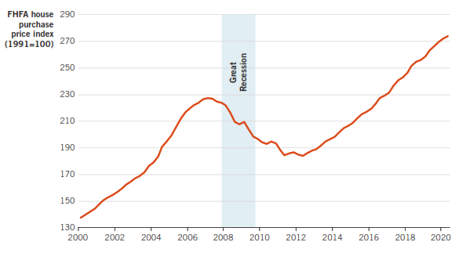
U.S. House Purchase Price Index, 2000-2020

Slide 23
Decline in AD in Great Recession
While institutional breakdowns affected AS, AD was also affected by:
decrease in wealth:
Real estate is often the single largest portion of wealth.
Stocks lost pme-third of their value in 2008.
decrease in expected income:
People realized the economy was faltering.
Consumer spending decreases during times of uncertainty.

Slide 24
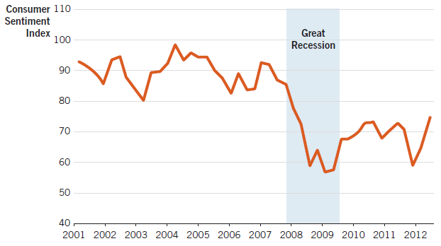
Consumer Sentiment Index

Slide 25
Great Recession, AS and AD Analysis

Slide 26
Great Recession in Numbers
Second quarter of 2007 (pre-recession):
Unemployment was below 5%.
Real GDP was growing at 3.6%.
Fourth quarter of 2008 (during the recession):
Unemployment was 10%.
Real GDP declined at an annual rate of 8.9%.
In 2012 (recession officially over):
Real GDP was growing at a rate of less than 2%.
Unemployment remained at 8%.
World financial institutions remained fragile.

Slide 27
The Coronavirus Recession (V-shaped)
Real GDP plummeted in 2nd quarter of 2020.
Fastest rate since the Great Depression.
GDP returned to pre-COVID level by early 2021.
By 2022, back to pre-COVID trend.
April 2020: unemployment rate shot up to 14.7%.
Highest unemployment since Great Depression.
End of 2021: dropped back below 4%.

Slide 28
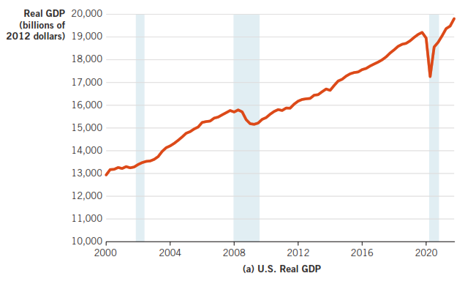
GDP during the Coronavirus Recession

Slide 29
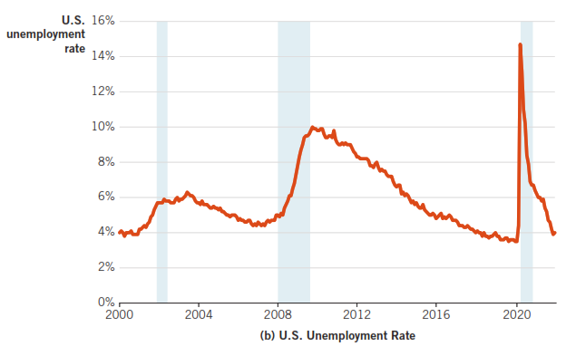
U.S. Unemployment, 2020-2021

Slide 30
The Supply Shock of the Coronavirus Recession
The pandemic was a classic supply shock.
A supply shock is an unexpected, exogenous event that abruptly shifts SRAS.
AD was also affected, but to a lesser extent than SRAS.
The cause was a decline in real wealth and in expectations of future income.
LRAS was not significantly impacted.

Slide 31
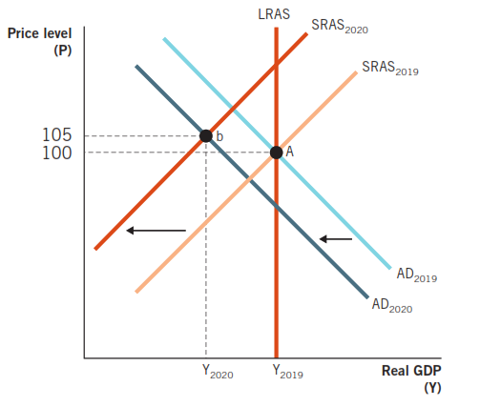
The Coronavirus Recession in the AD-AS Model

Slide 32
The Great Depression and Economic Theory
The conditions of the Great Depression were bad by almost any measure
Decade-long recession
From 1929 to 1933, real GDP fell 30%
25% unemployment in 1933
15% unemployment over the 1930s decade
And challenged the view of Classical economics.

Slide 33
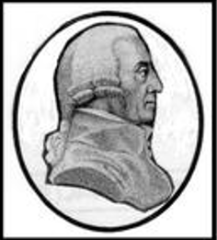
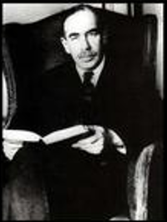
Major Macroeconomic Debate
Classical Economics
Adjustment toward long-run equilibrium will happen naturally.
Prices are flexible.
Let the economy go and the market will correct itself.
Keynesian Economics
Adjustment will be long and occur unpredictably with many delays.
Prices are sticky.
Call for government interventions in the market.

Slide 34
Keynesian Economics
Focus on the demand side of the economy as the source of instability.
Government intervention is needed in prolonged recessions to boost demand and restore the economy to long-run equilibrium.
Keynes: “In the long run, we are all dead.”

Slide 35
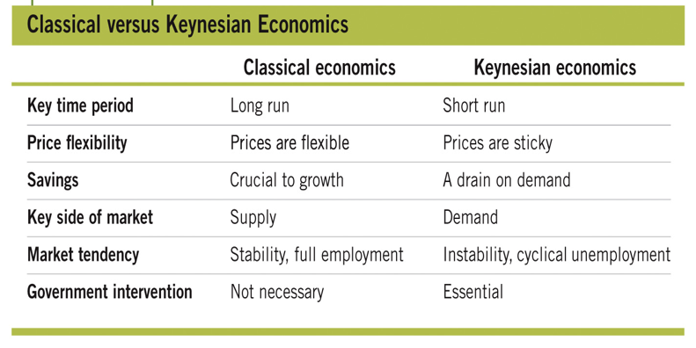
Major Macroeconomic Debates

Slide 36
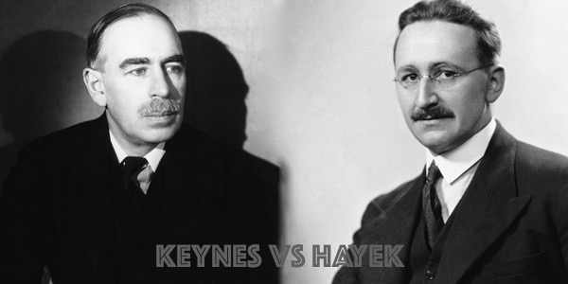
Keynes vs. Hayek
Keynes: government intervention needed
Hayek: leave the market alone

Slide 37


Slide 38
Conclusion
In the recent Great Recession & COVID-19 recession, we experienced lower output and high unemployment.
However, the Great Depression in the 1930s was much worse and lasted much longer.
Classical economists:
market is self-correcting
focus on long-run growth
Keynesian economists:
market corrections can take a long time due to sticky wages
focus on policy aimed at stimulating demand

